Slide 1
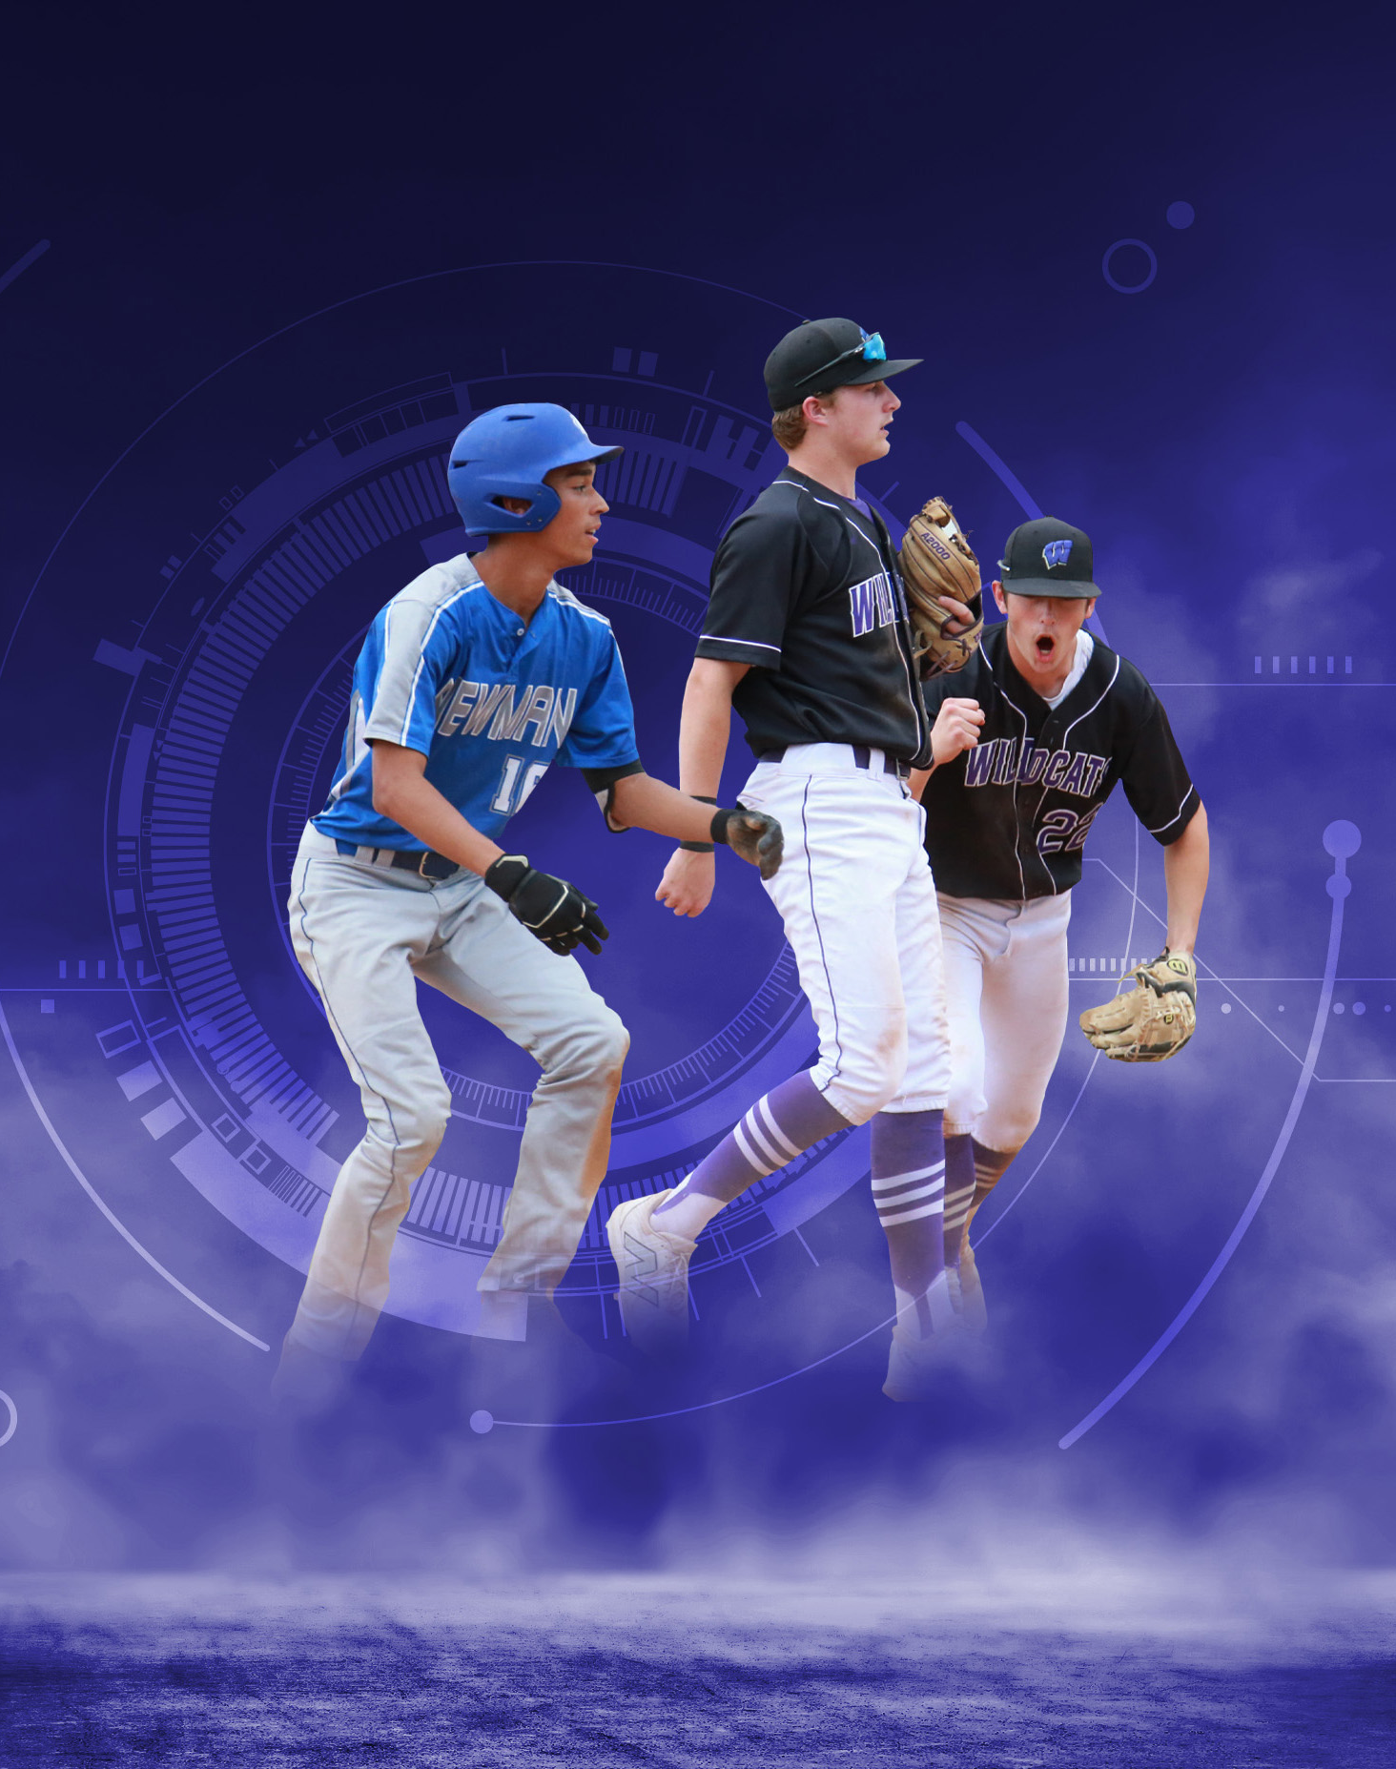
2026 NFHS
Baseball
Rules PowerPoint
Rules Changes
Editorial Changes
Mechanical Changes
Points of Emphasis

Slide 2
NFHS Information

Slide 3









NFHS Rules Review Committee
The NFHS Rules Review Committee is chaired by the chief operating officer and composed of all rules editors. After each committee concludes its deliberations and has adopted its recommended changes for the subsequent year, such revisions will be evaluated
by the Rules Review Committee.
Davis Whitfield
Chief Operating Officer
Lindsey Atkinson
Boys & Girls Lacrosse and Volleyball
Julie Cochran
Cross Country, Soccer and Track & Field
Bob Colgate
Flag Football, Football and Sports
Medicine
Elliot Hopkins
Baseball and Wrestling
Monica Maxwell
Basketball, Field Hockey and Girls Gymnastics
Dan Schuster
Ice Hockey
Sandy Searcy
Softball, Swimming & Diving and Water Polo
James Weaver
Spirit

Slide 4








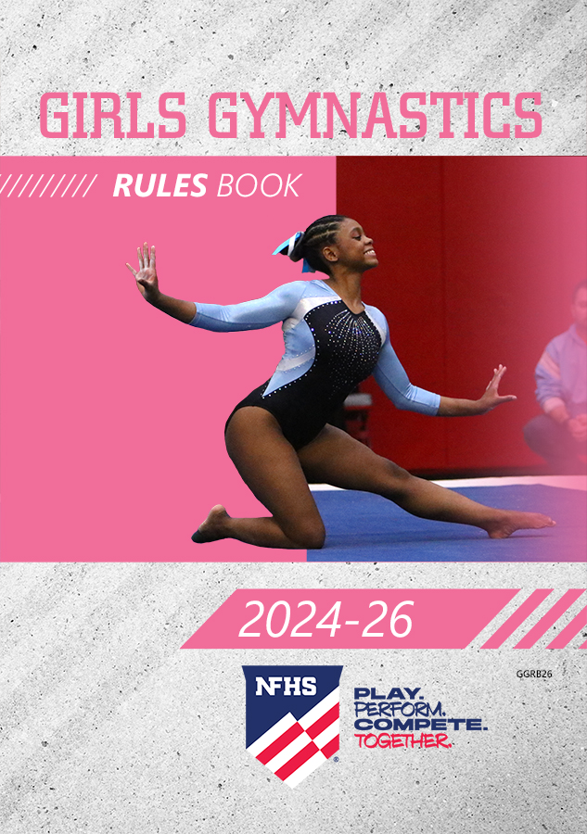








NFHS Publications
The NFHS writes playing rules for 18 sports
for boys and girls at the high school level.
  Publishes 2 million pieces of materials annually.

Slide 5


NFHS Digital
NFHS Digital is the New Publications Platform that includes:
  Rules Books
  Case Books
  Officials Manuals
  Policy Debate Quarterly
  Other NFHS Publications
Visit nfhs.org/NFHSDigital

Slide 6

NFHS Digital – Mobile App
Access via Mobile App:
  View available publications for sale
  View publications assigned to you
  Create comments and save notes
  Highlight important content to review later
  Available on App Store and Google Play

Slide 7
2026 NFHS Baseball
Rules Changes

Slide 8
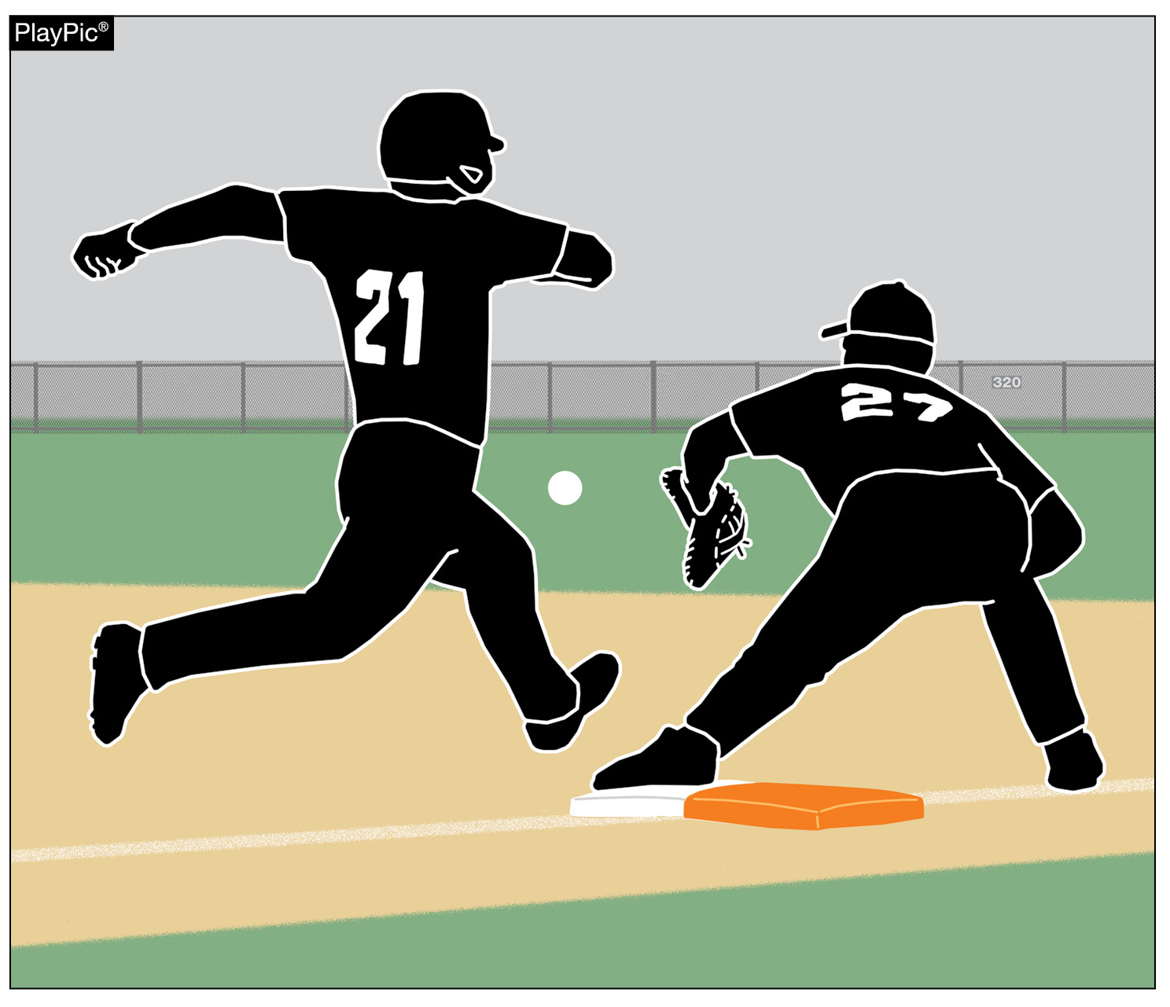
DOUBLE FIRST BASE
1-2-9, 2-5-1h, 2-16-1h, 8-2-1,
8-2-2a(1-7), 8-2-7
Starting in 2027, all high school baseball fields will be required to use the double first base.
State associations may implement the change in 2026.

Slide 9
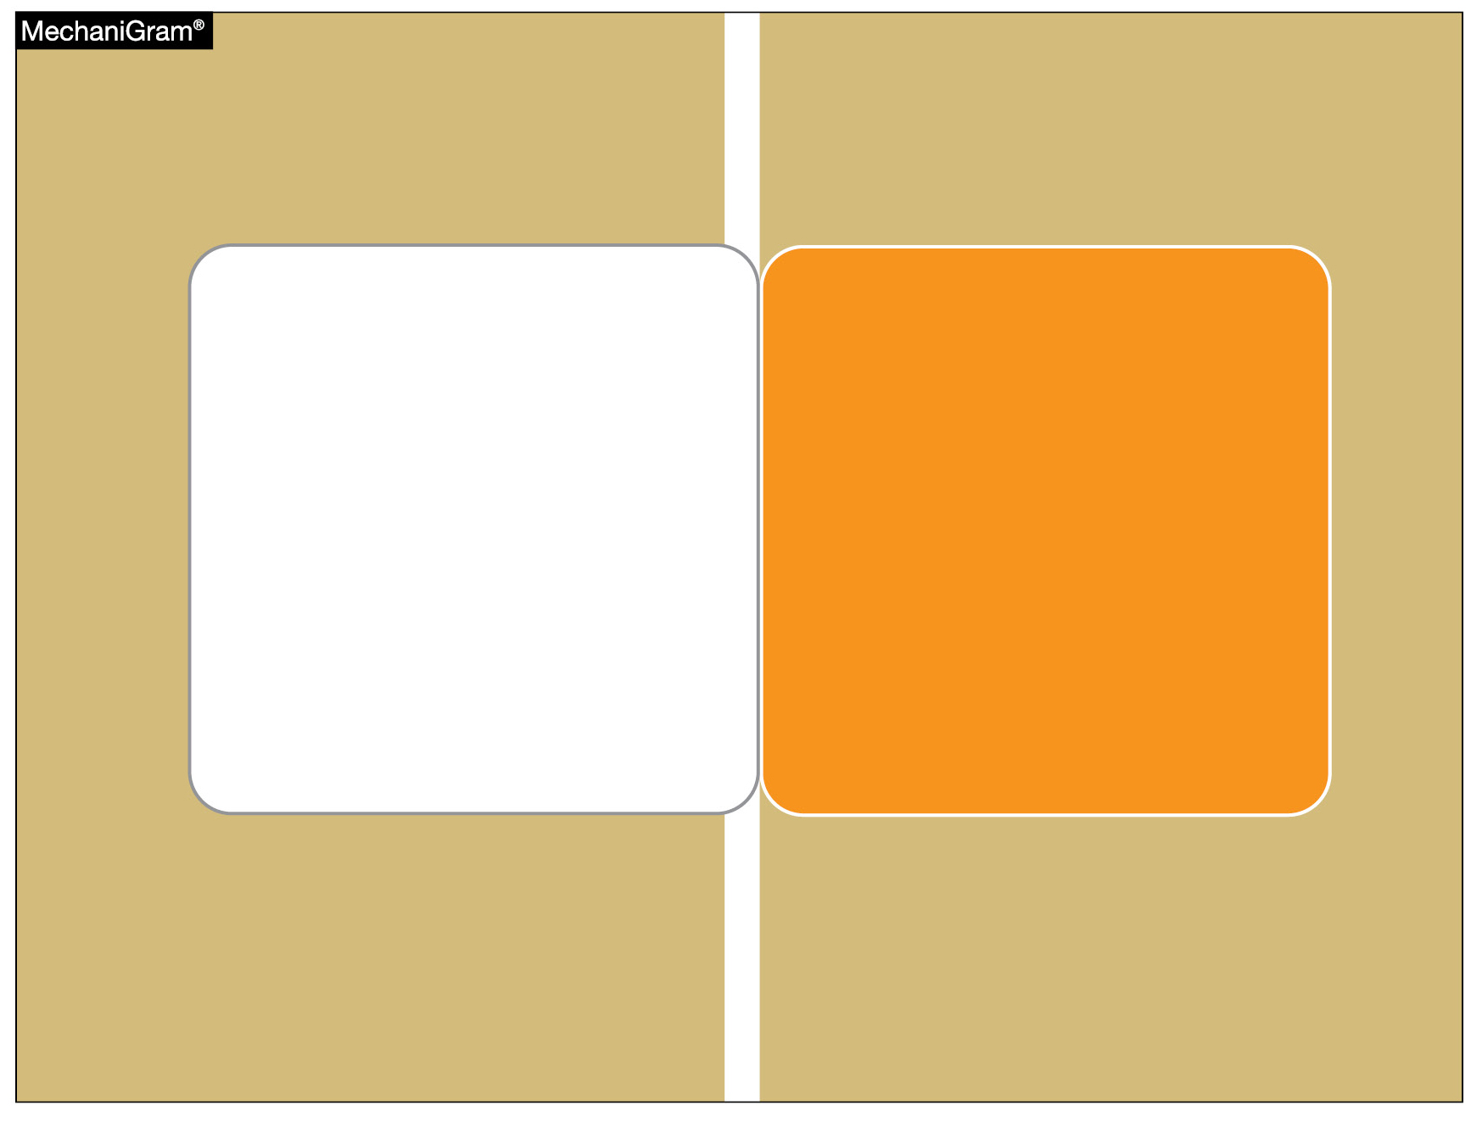
DOUBLE FIRST BASE
1-2-9

Slide 10
DOUBLE FIRST BASE
1-2-9
ART. 9 . . . Effective January 1, 2027, the double first base will be required. The double first base shall be a white base and a contrasting solid color. The white portion of the base is located in fair territory and the colored portion is located in foul territory. The double first base is split by the first base foul line. They shall be installed with no space between the two portions of the double first base. Both double first bases (white and colored), second and third bases shall be white bags…their anchor systems.

Slide 11
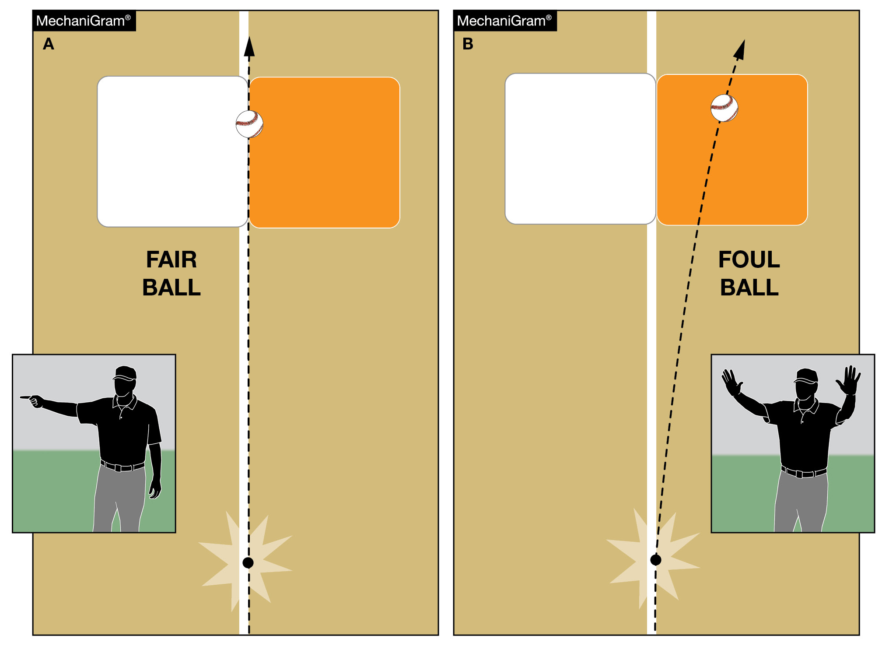
DOUBLE FIRST BASE
2-5-1h, 2-16-1h

Slide 12
DOUBLE FIRST BASE
2-5-1h
ART. 1 . . . A fair ball is a batted ball which:
a.- g. Remains the same.
h. hits or bounds over any portion of the white portion of the double first base.

Slide 13
DOUBLE FIRST BASE
2-16-1h
ART. 1 . . . A foul ball is a batted ball which:
a.- g. Remains the same.
h. hits or bounds over the contrasting color portion of the double first base without first being a fair ball.

Slide 14
DOUBLE FIRST BASE
8-2-1

Slide 15
DOUBLE FIRST BASE
8-2-1
ART. 1 . . . An advancing runner shall touch first, second, third and then home plate in order, including awarded bases. A batter-runner shall use the colored base on the initial play at first base sunless the fielder is drawn to the side of the colored base (dropped third strike only), in which case the batter-runner would touch the white base and the fielder to the colored base. On a dropped third strike, fielder and batter-runner may touch white or colored base.

Slide 16

DOUBLE FIRST BASE
8-2-2a(1-7)

Slide 17
DOUBLE FIRST BASE
8-2-2a(1-7)
ART. 2 . . . A returning runner shall retouch the bases in reverse order. If the ball is dead because of an uncaught foul, it is not necessary for a returning runner to retouch intervening bases. The umpire will not make the ball live until the runner returns to the appropriate base.

Slide 18
DOUBLE FIRST BASE
8-2-2a(1-7)
a. Runners tagging up on fly balls, leading off on a pitch, or returning to first base on an attempted pick-off can only use the white portion of the base. A defensive player may use only the fair portion of the base when a play is being made on the batter-runner on any live ball from within the foul lines or from third base foul line It is interference when the batter-runner, on a force play, touches only the white portion of the base and collides with the fielder in the process of catching a thrown ball while on the white portion of the base.

Slide 19
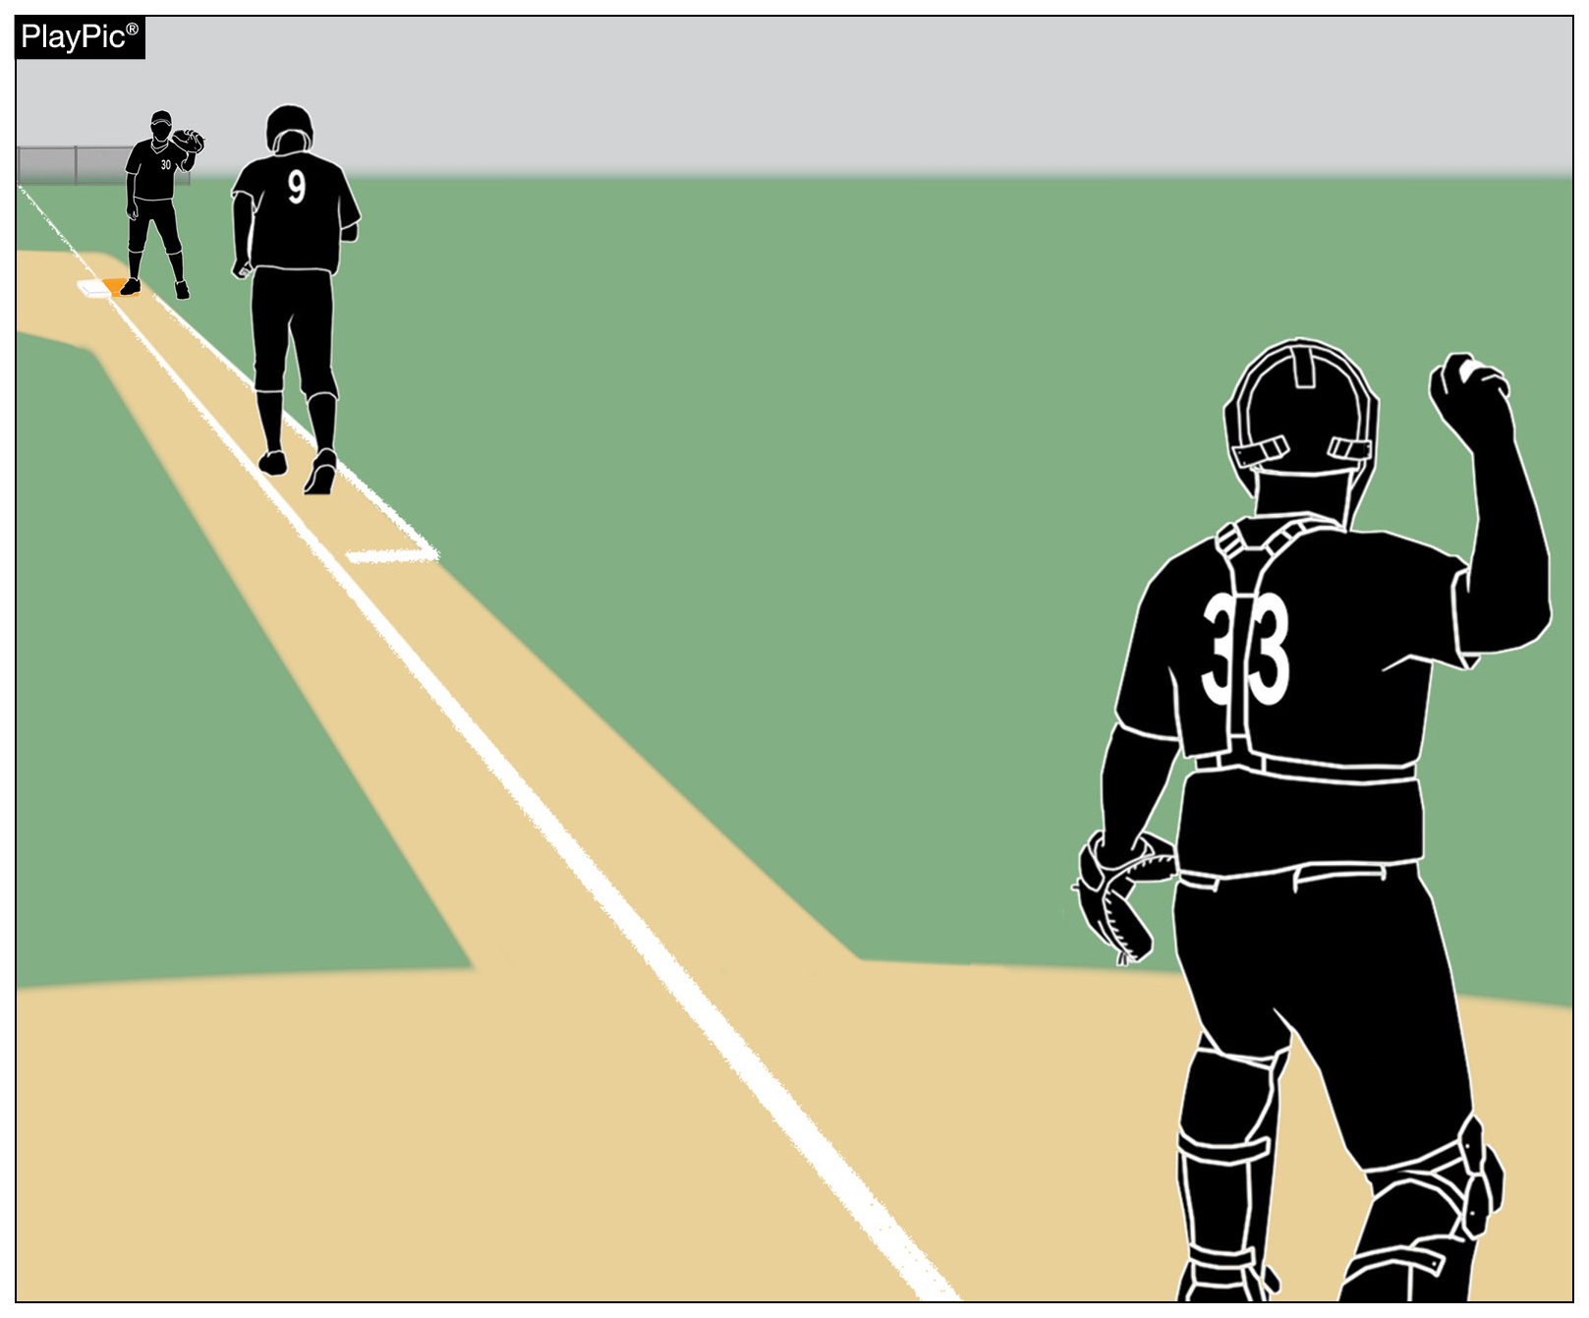
DOUBLE FIRST BASE
8-2-2a(1-7)
The lone exception is when there is a dropped third strike, in which case the batter-runner may use the white portion of the base and the fielder may use the colored portion of the base.
On a dropped third strike, both the fielder and runner may use either portion of the base.

Slide 20
DOUBLE FIRST BASE
8-2-2a(1-7)
Obstruction is called on the defense when there is a force play on the batter-runner, who touches only the colored portion and collides with the fielder about to catch a thrown ball while also on the colored portion of the base.
1. The batter-runner should use the colored base on the initial play at first base, unless the fielder is drawn to the colored base because of a dropped third strike, in which case the BR would go to the white base only.

Slide 21
DOUBLE FIRST BASE
8-2-2a(1-7)
2. Once the batter-runner reaches first base, the runner must always return to the white base.
3. On extra base hits or other balls hit to the outfield when there is no chance for a play to be made at the double first base, the batter-runner may touch either the white or colored section of the base.
4. When tagging up on a fly ball, the white section of the base must be used by the runner. One foot is permitted to extend behind or on the colored base provided the front foot is touching the white section of the base.

Slide 22
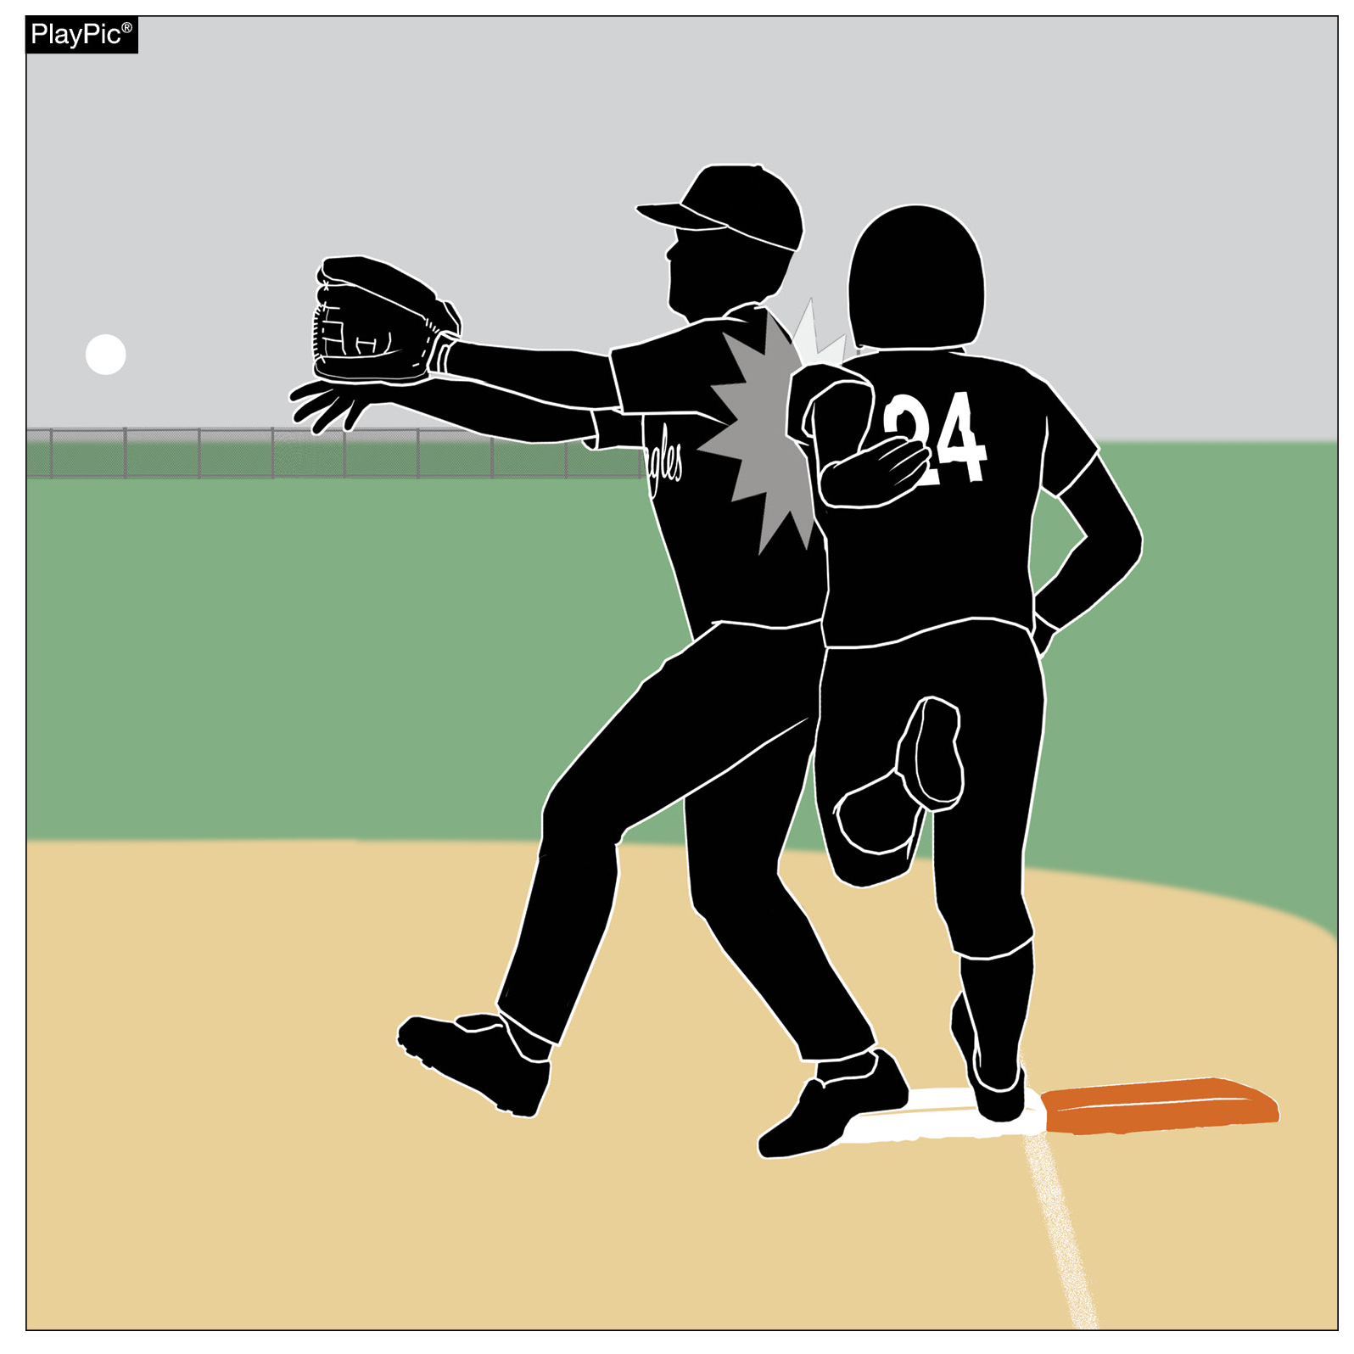
DOUBLE FIRST BASE
8-2-2a(1-7)
If a batter-runner on a force play touches only the white portion of the base and collides with a fielder who is entitled to catch a thrown ball while touching the white portion of the base, interference should be ruled.

Slide 23
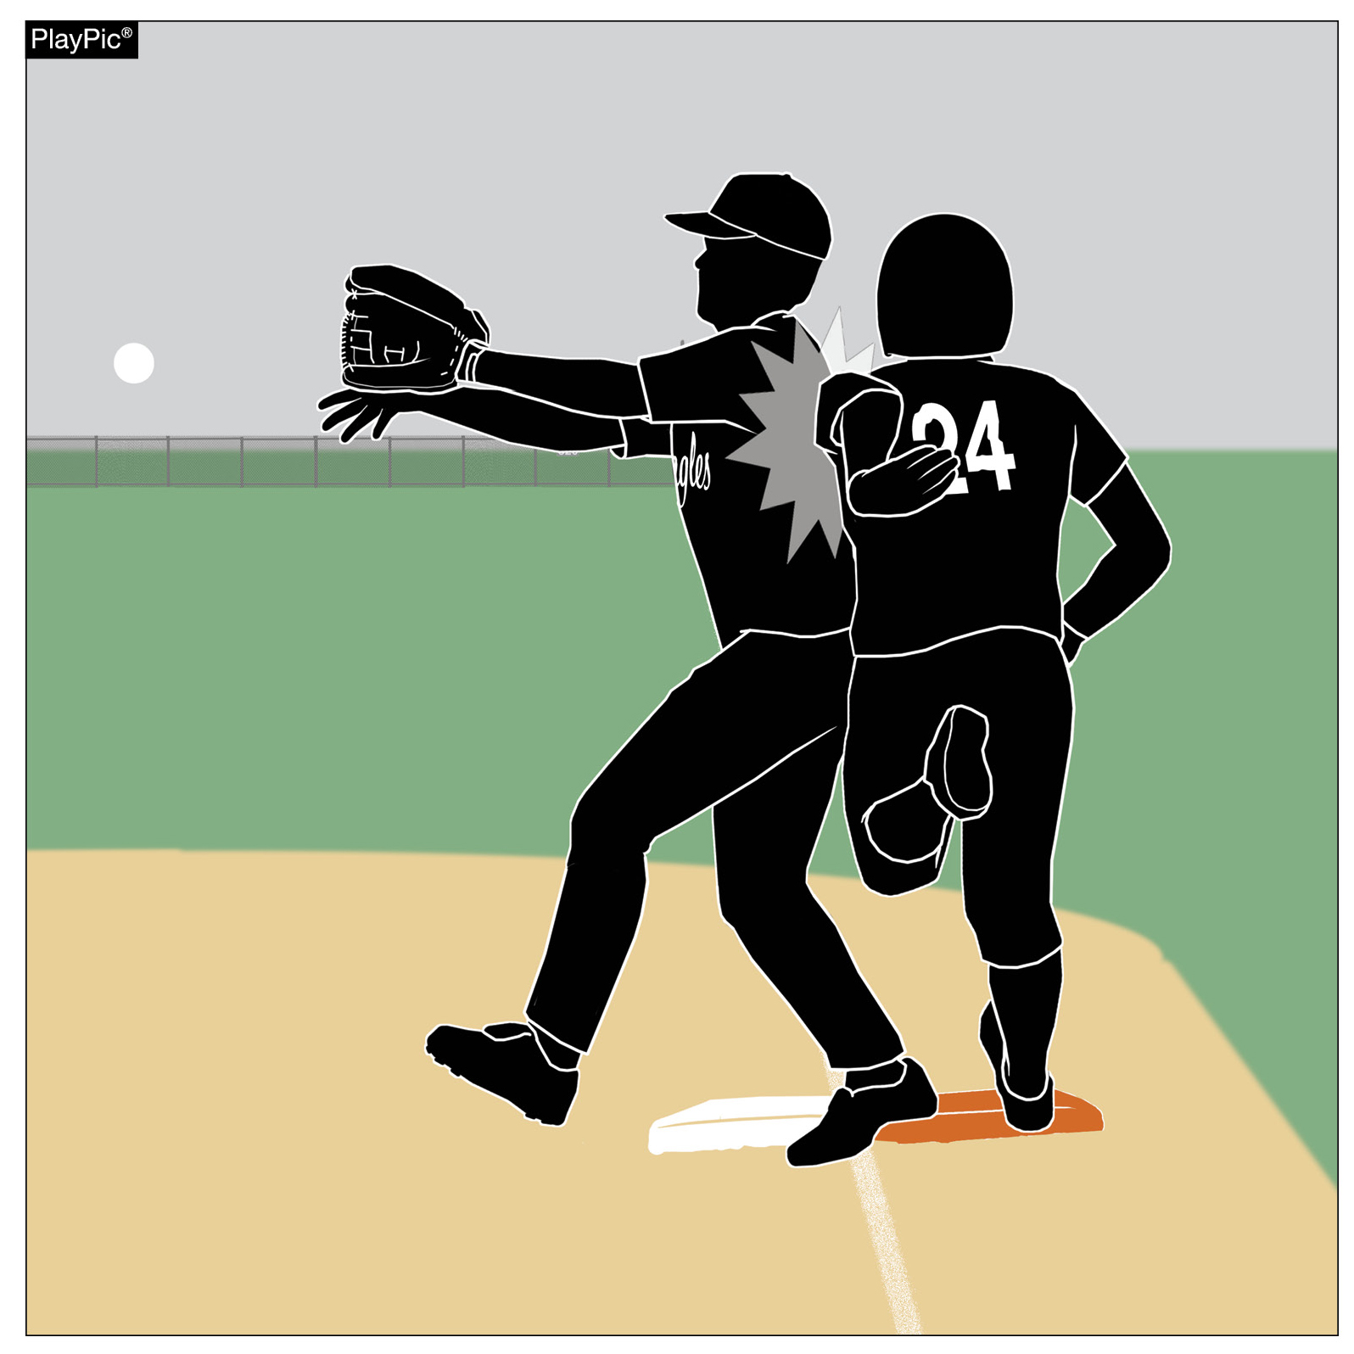
DOUBLE FIRST BASE
8-2-2a(1-7)
If a batter-runner on a force play touches only the colored portion of the base and collides with a fielder who is not legally entitled to catch a thrown ball while touching the colored portion of the base, obstruction should be ruled.

Slide 24
DOUBLE FIRST BASE
8-2-2a(1-7)
5. On attempted pick-off plays, the runner must return to the white section of the base only. This includes a throw from the pitcher, catcher, or any other player, in an attempt to retire the runner at the double first base.
6. The double first base does not change any other rule concerning interference or obstruction at first base. The batter-runner must still avoid interference with the fielder attempting to field a batted ball.

Slide 25
DOUBLE FIRST BASE
8-2-2a(1-7)
7. On base on balls, the offense or the defense may touch either the white or colored base.

Slide 26
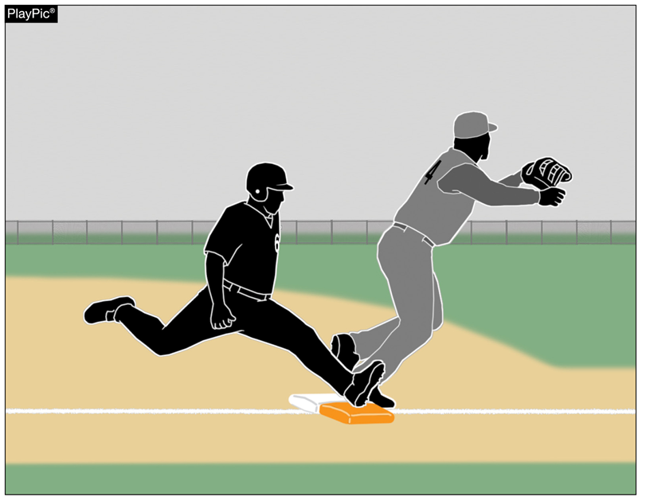
DOUBLE FIRST BASE
8-2-7

Slide 27
DOUBLE FIRST BASE
8-2-7
ART. 7 . . . A batter-runner who reaches first base safely and then overruns or over slides may immediately return without liability of being put our provided the batter-runner does not attempt or feint an advance to second. Once the batter-runner reaches first base (colored), the runner shall use the white base.

Slide 28
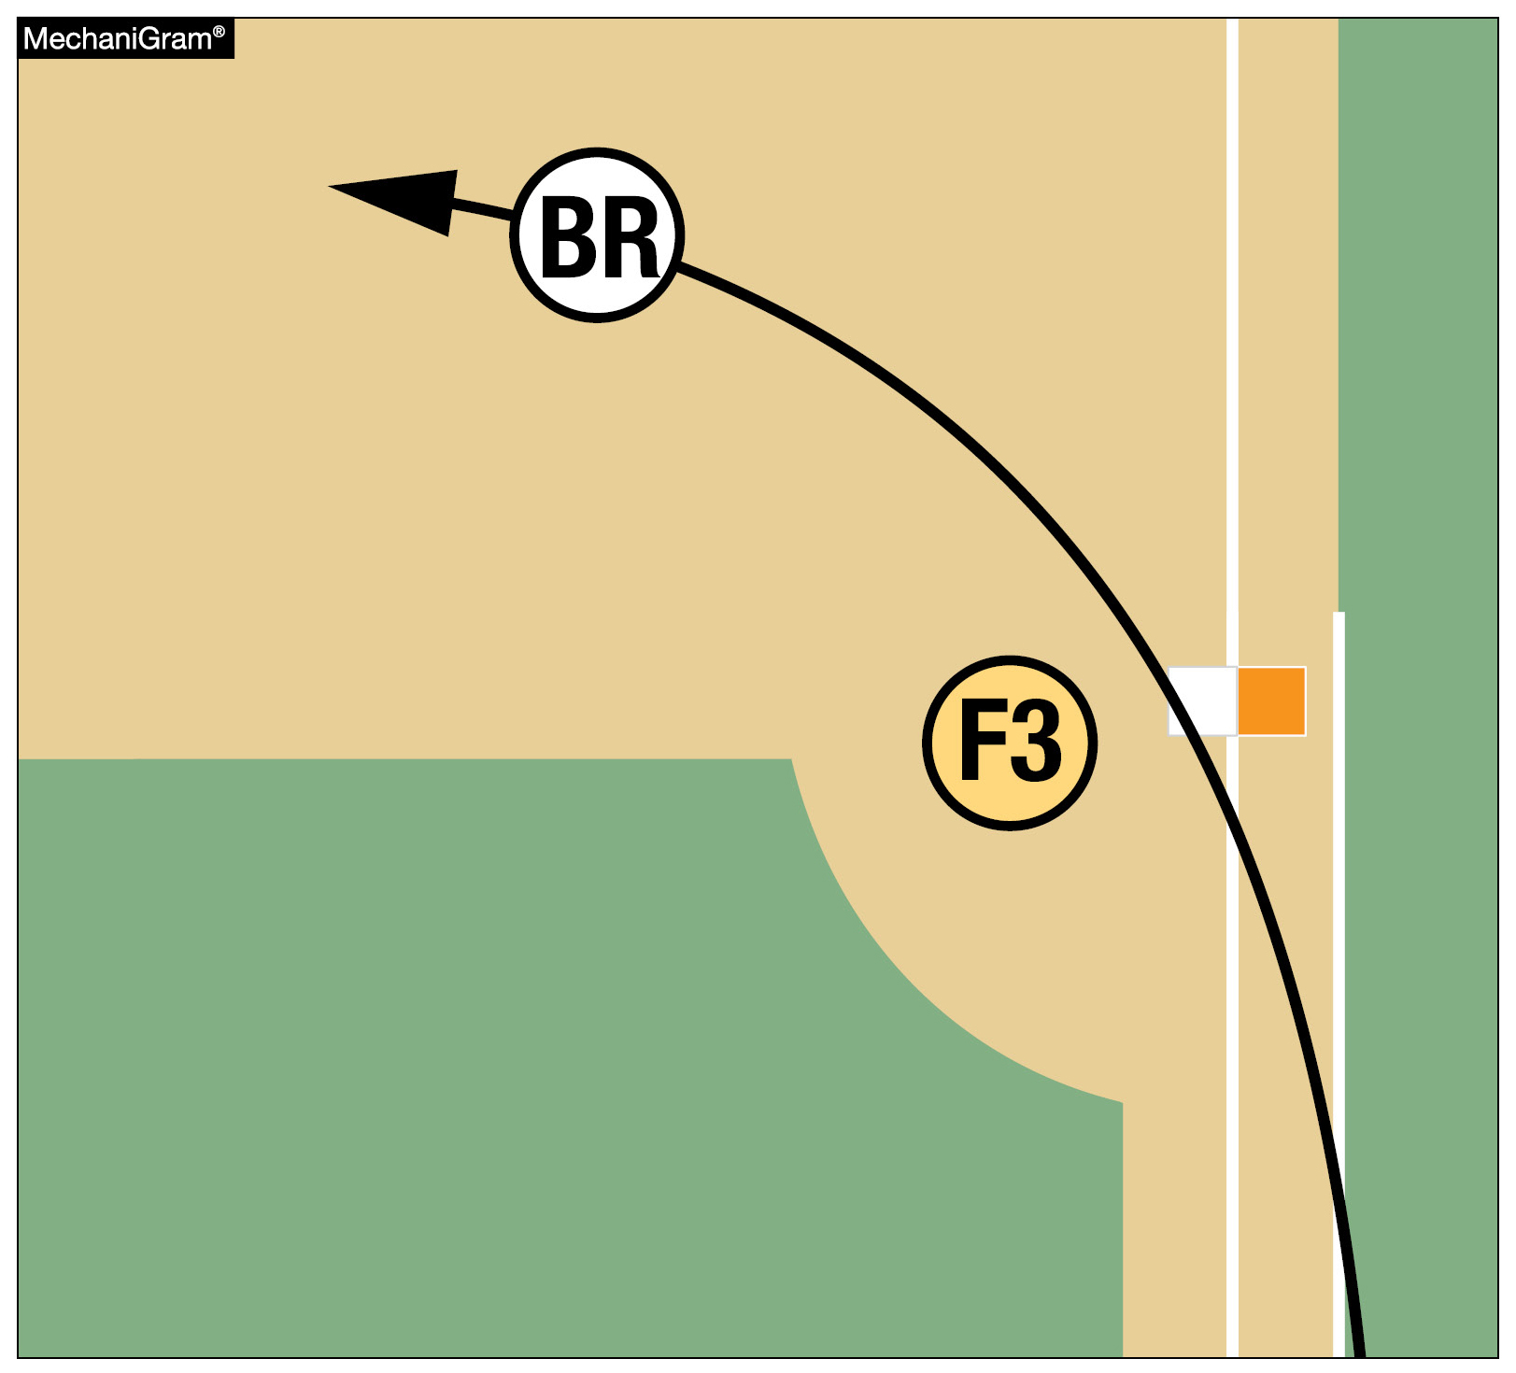
DOUBLE FIRST BASE
1-2-9, 2-5-1h, 2-16-1h, 8-2-1,
8-2-2a(1-7), 8-2-7
On extra-base hits or other balls hit to the outfield when there is no chance for a play to be made at the double first base, the batter-runner may touch either portion of the base.
Once a batter reaches first base safely, the colored portion of the base essentially disappears, and all legal touches of first base require the use of the white portion of the base.

Slide 29
DOUBLE FIRST BASE
1-2-9, 2-5-1h, 2-16-1h, 8-2-1,
8-2-2a(1-7), 8-2-7
Rationale: Risk minimization.

Slide 30
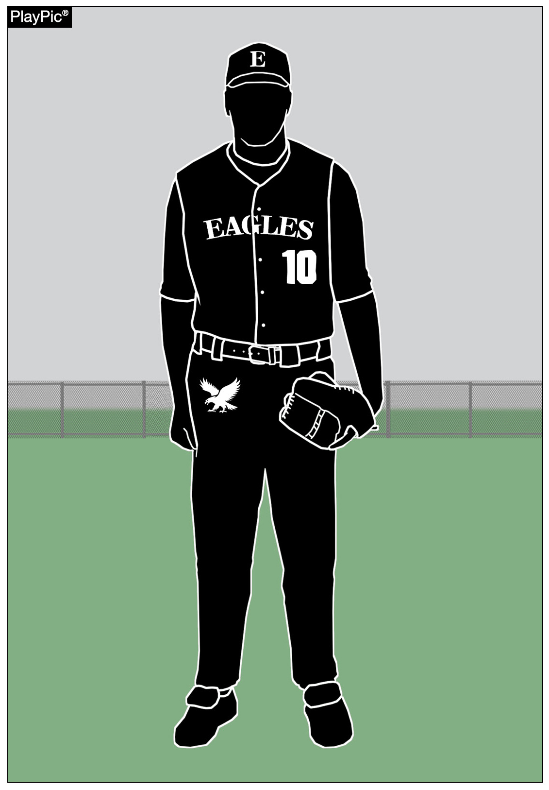
UNIFORMS
1-4-4

Slide 31
Rule 1-4-4
ART. 4 . . . The school's official uniform… (The same restriction shall apply to either the manufacturer's logo/trademark or reference.) Effective, January 1, 2027, The school's name, school nickname, school logo, school mascot, and/or the player's name are permitted on the uniform top and/or pants. One American flag 2 inches x 3 inches may be worn or occupy space on each item of uniform apparel.
Rationale:
This is a universal rule adaptation by every NFHS Rules Committee to be uniformed for every NFHS rule publication.

Slide 32
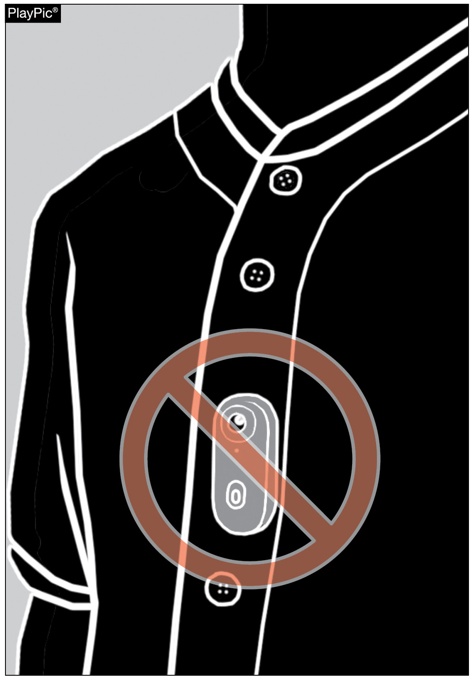
PLAYER EQUIPMENT
Rule 1-6-3

Slide 33
Rule 1-6-3
Articles 1 and 2 remain the same.
ART. 3 . . . No player shall wear any audio (microphone) or video (camera) device during the game.
Rationale: No player participating in the game will be allowed to wear any type of audio or video device to record or transmit audio or video. This is a universal rule adaptation by every NFHS Rules Committee to be uniformed for every NFHS rule publication.

Slide 34
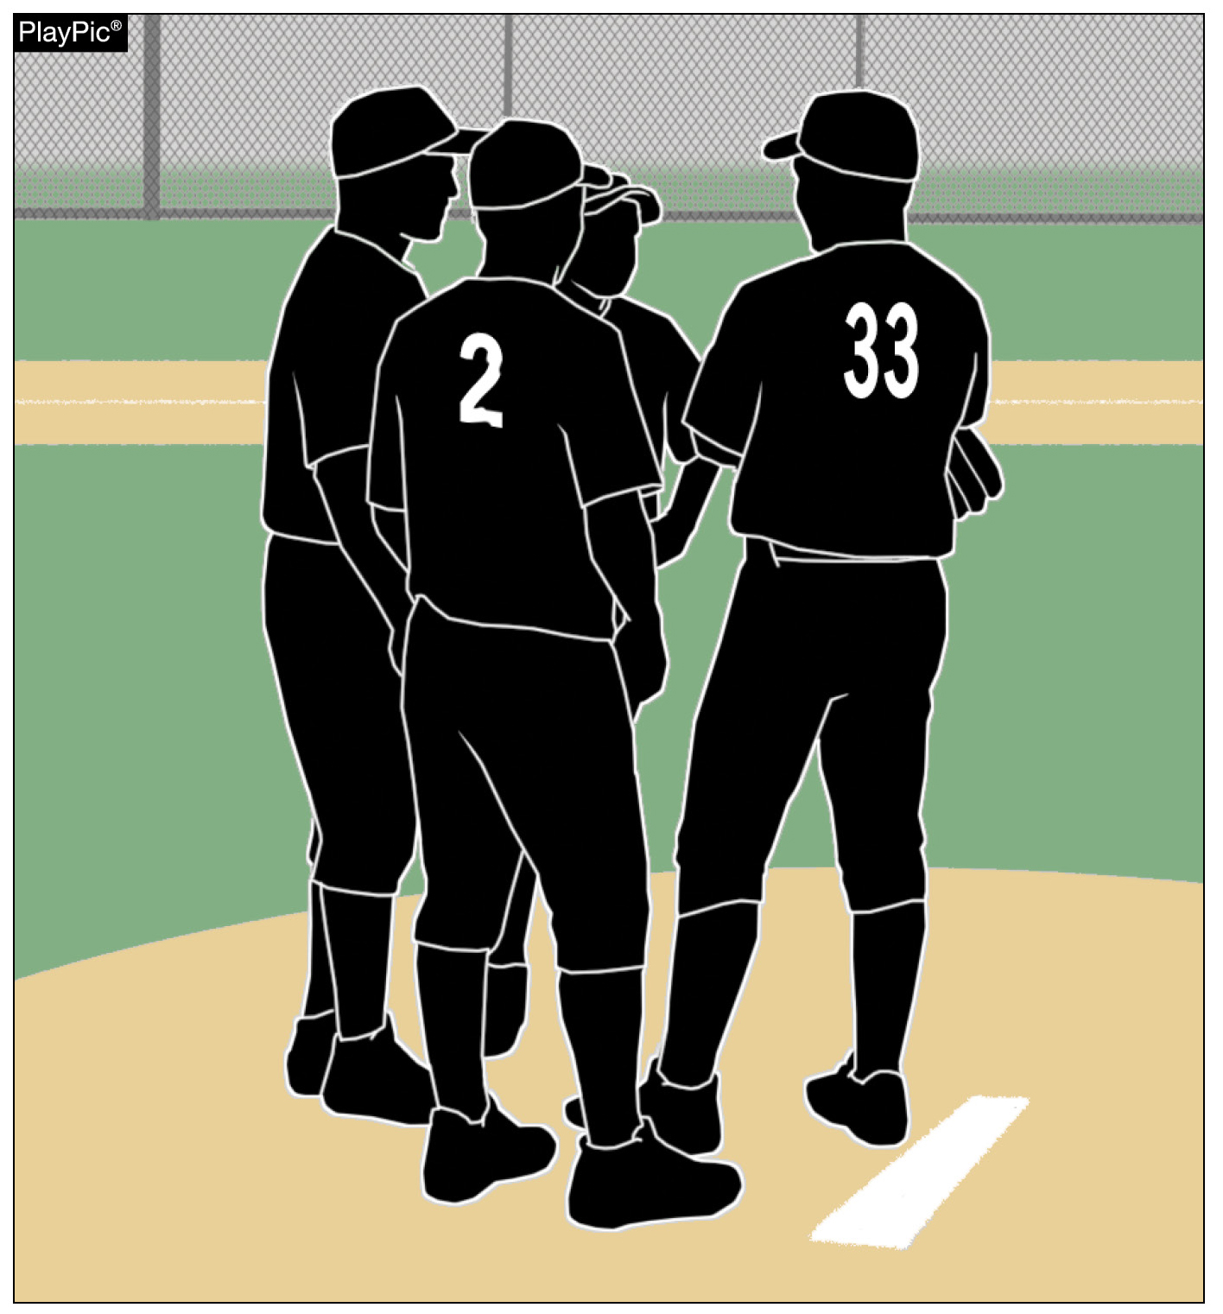
MEETINGS
Rule 2-10-3, 3-4-6

Slide 35
Rule 2-10-3
ART. 3 . . . A player-to-player defensive meeting includes two or more players (3-4-6).
Rationale: Definition for player-to-player meeting.

Slide 36
MEETINGS
Rule 3-4-6
ART. 6 . . . Each team, when on defense, may be granted not more than one player-to-player meeting during an inning to permit players to confer with defensive personnel. The umpire shall deny any subsequent player-to-player defensive team requests for meetings.
Notes:
The following plays are not defined as player-to-player meetings:
Injury time-outs for either offense or defense. Players will be able to meet without penalty during an injury time-out.
Offensive Time-out – If the offense calls time, the defensive players can meet and not be in violation of the rule.
Other Team Conferences – If the other team conferences, the defensive players can meet and not be in violation of the rule.
After Putout (Outfield) – After a putout in the outfield, with no runners on base, the ball shall be thrown to a cutoff player and if desired to one additional player before being returned to the pitcher. The returner can either throw the ball to the pitcher or walk it to them with words of encouragement or a congratulatory message.
After Putout (Infield or Strikeout) - After a putout in the infield, with no runners on base, the ball shall be returned directly to the pitcher. The returner can either throw the ball to the pitcher or walk it to them with words of encouragement or a congratulatory message.
Fifth Warm-up Pitch– Upon the fifth warm-up pitch at the start of the half-inning, the catcher can either throw the ball to the pitcher or walk it to them with words of encouragement or a congratulatory message.

Slide 37
Rule 3-4-6
Rationale: Utilizing the rule addition will improve the pace of play, while still allowing the meetings to continue. Currently there is not a limit on defensive player-to-player meetings. This will prevent teams from stalling when the weather or darkness is approaching.

Slide 38
2026 NFHS Baseball
Editorial Changes

Slide 39
Rule 8-4-1g1
This infraction is ignored if it is to avoid a fielder who is attempting to field the batted ball.
1. The batter runner is considered outside the running lane lines if either foot is outside either line.
Rationale: This rule was voted by the NFHS Baseball Rules Committee to be deleted, but the change was not included in the 2026 NFHS Baseball Rules Book. Please note that the running lane violation is not enacted if the ball is not thrown to first base.

Slide 40
2026 NFHS Baseball
Points of Emphasis

Slide 41
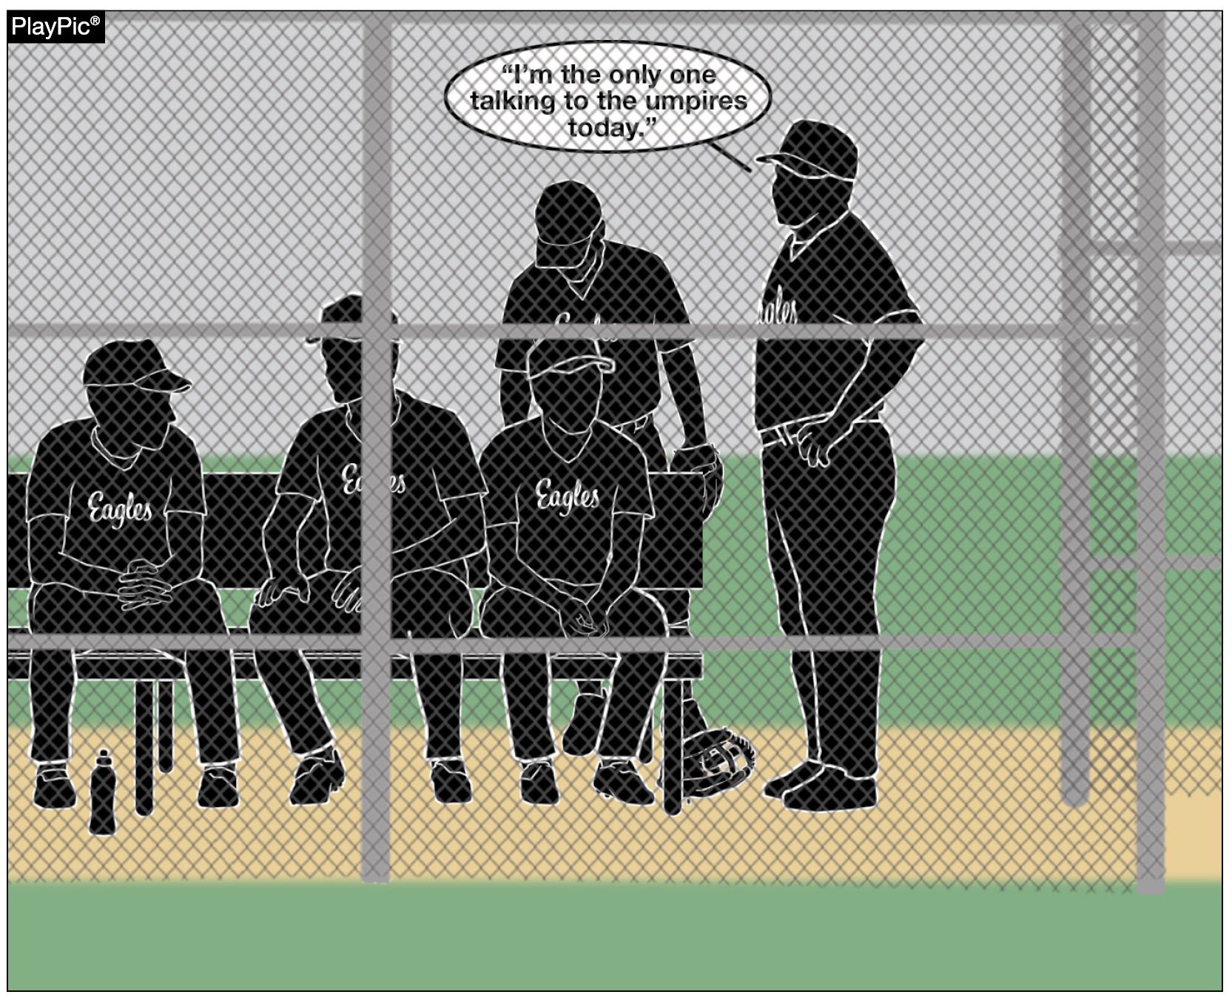
DISCIPLINE
Any unsportsmanlike conduct, arguing or disrespect directed toward umpires will result in disciplinary action, which may include warnings, restriction to the bench or ejection from the game (3-3-1 to 3-3-4 and 10-2-3).

Slide 42
DISCIPLINE
These penalties are not punitive in nature – they are protective of the values that define high school sports: respect, integrity and personal responsibility.

Slide 43
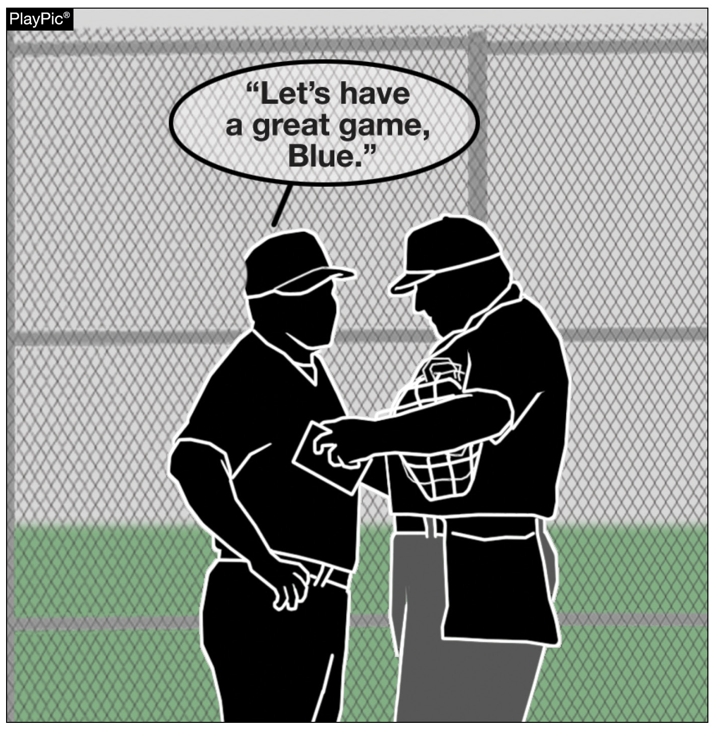
DISCIPLINE
Respect for officials is a reflection of the maturity, leadership and character we hope to instill in all participants through educational athletics.

Slide 44
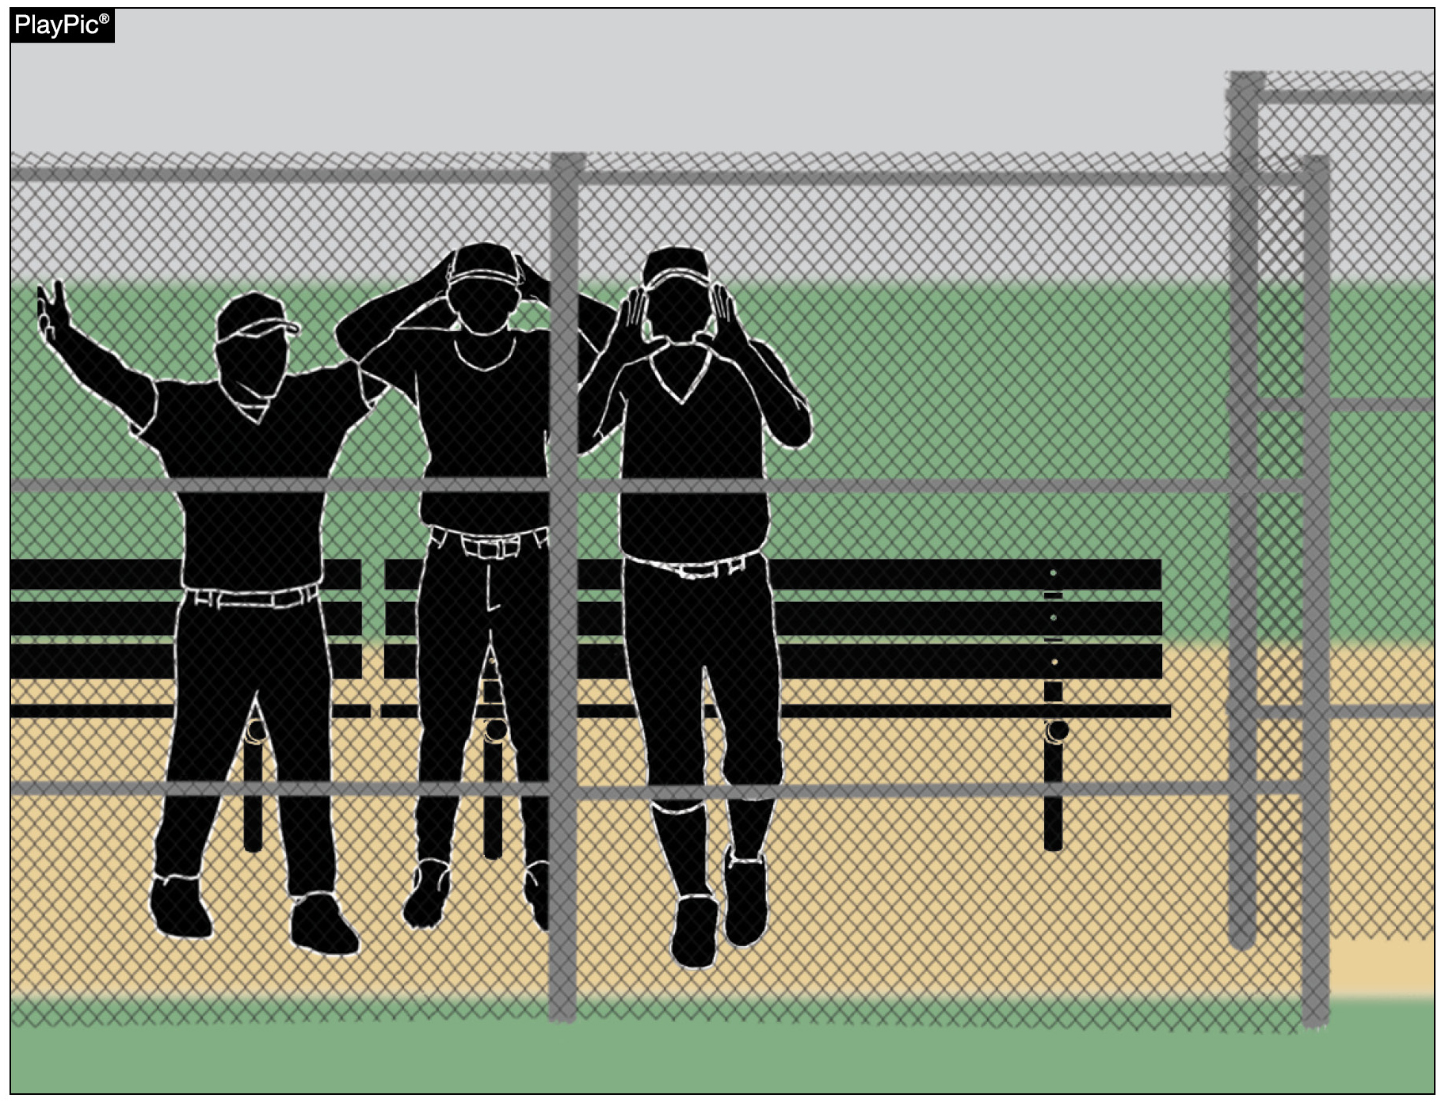
SPORTSMANSHIP
(BENCH JOCKEYING AND PROPS)
Bench jockeying can be considered as negative verbal comments, taunting or attempts to distract, intimidate or embarrass opponents or officials from the dugout – violates the standards of conduct expected in interscholastic competition.

Slide 45
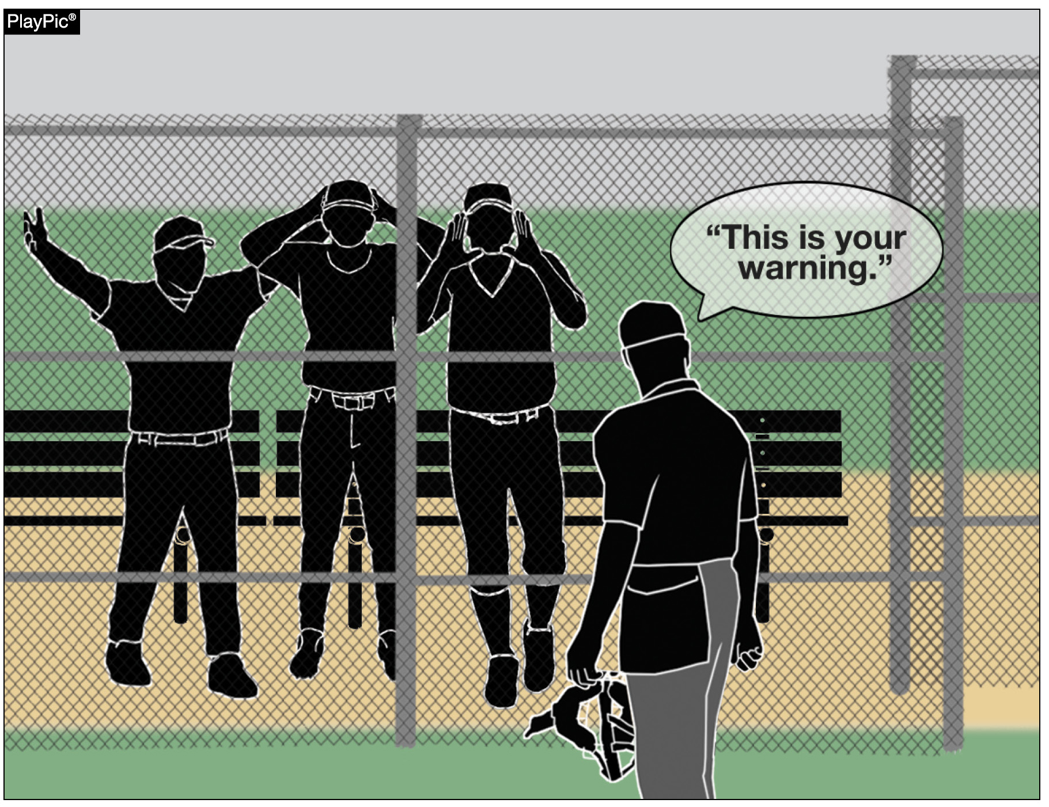
SPORTSMANSHIP
(BENCH JOCKEYING AND PROPS)
By rule, bench jockeying is prohibited and will result in warnings, restrictions or ejections as deemed appropriate by the umpire.

Slide 46
SPORTSMANSHIP
(BENCH JOCKEYING AND PROPS)
Enforcement of this rule is not about silencing enthusiasm – it is about upholding the spirit of fair play and modeling appropriate conduct for students, schools and communities.

Slide 47
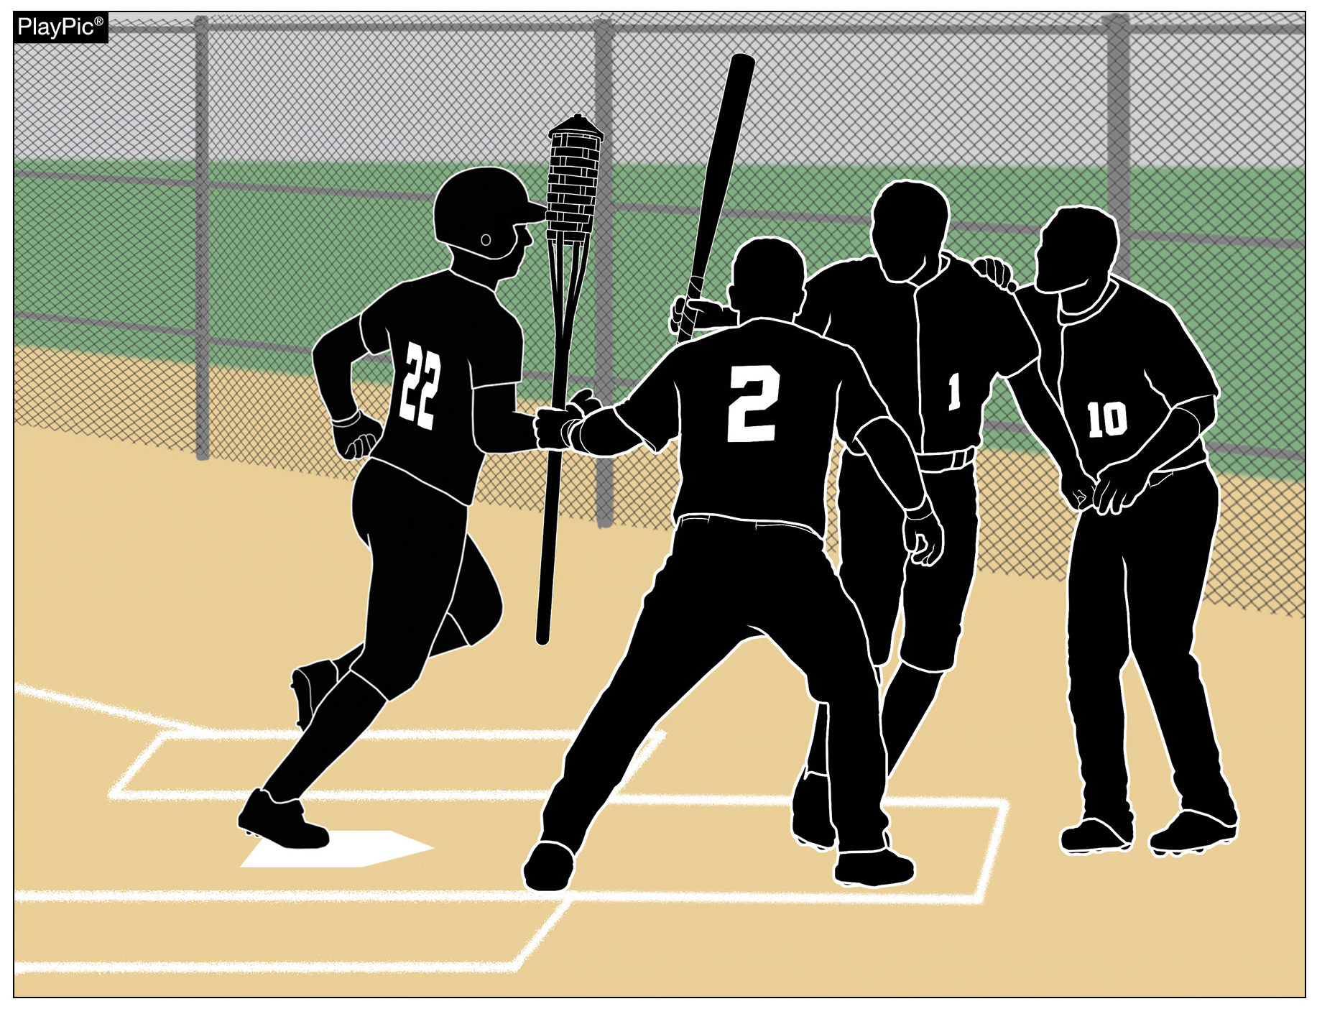
SPORTSMANSHIP
(BENCH JOCKEYING AND PROPS)
There is no logical purpose to have props at an education-based athletic event.

Slide 48
SPORTSMANSHIP
(BENCH JOCKEYING AND PROPS)
The dugout should be a place of encouragement and unity, not derision and distraction.
Let the game be decided by skill, preparation and respect – not by unnecessary noise and antics.

Slide 49
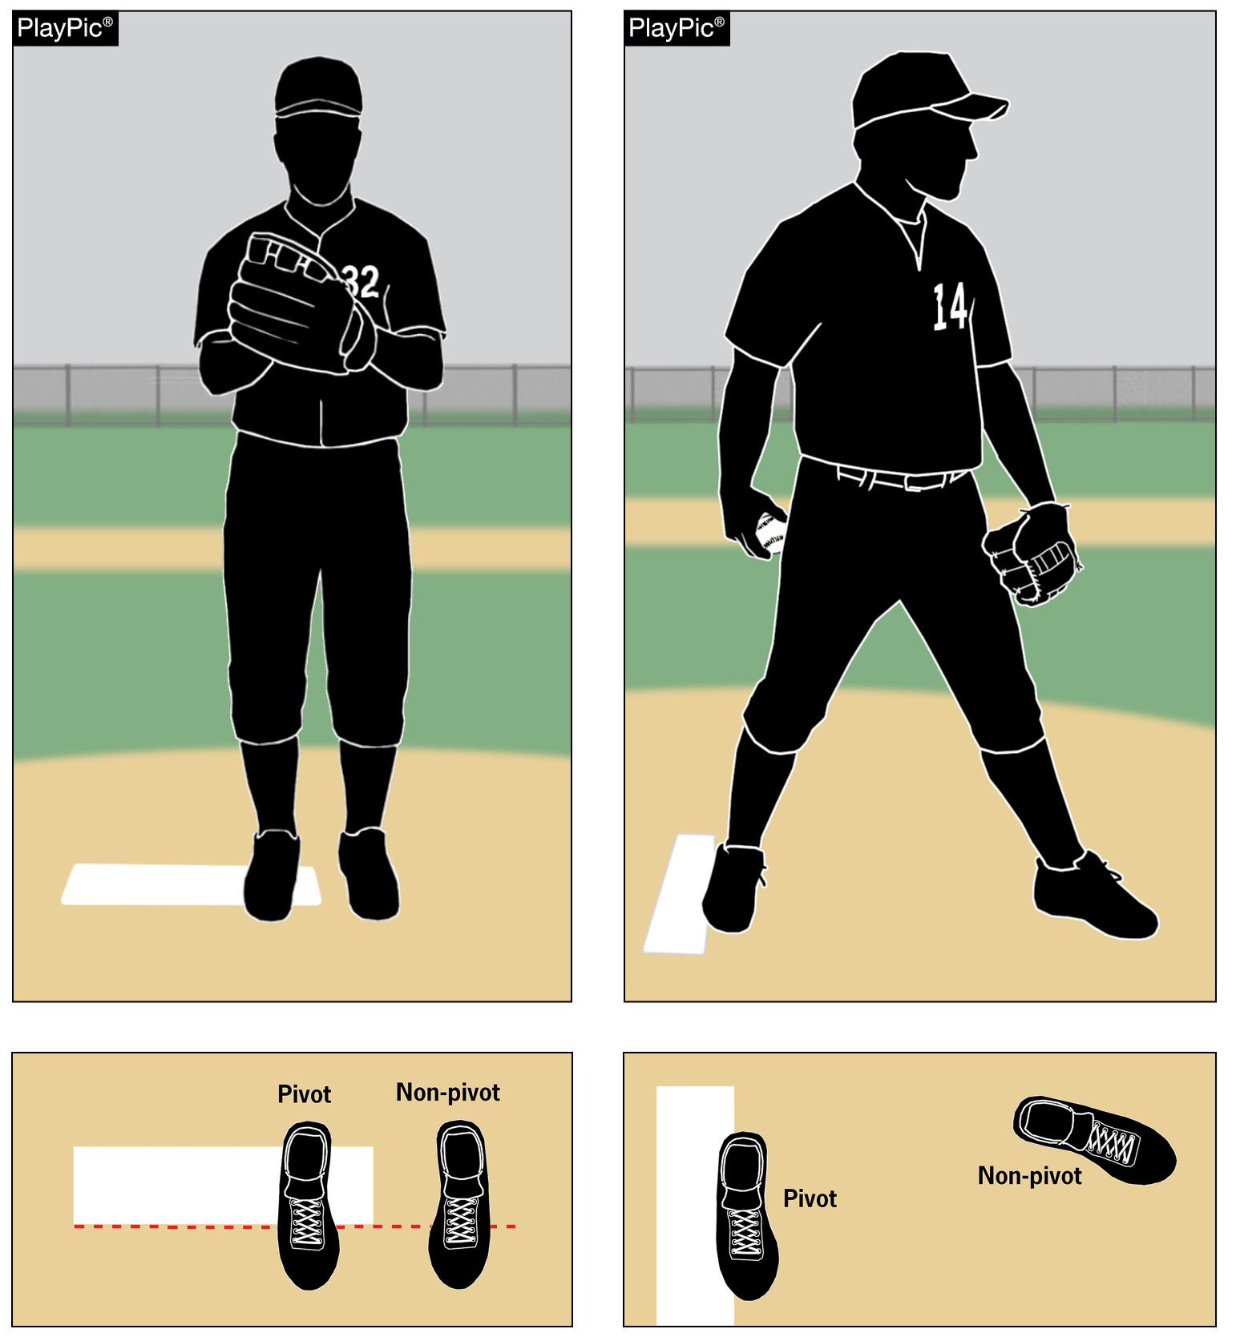
PROPER PITCHING POSITIONS
Pitchers are required to use one of two positions: the wind-up or the set.
It is important that umpires, coaches and players know what position the pitcher is using so they know which part of Rule 6 is in play.

Slide 50
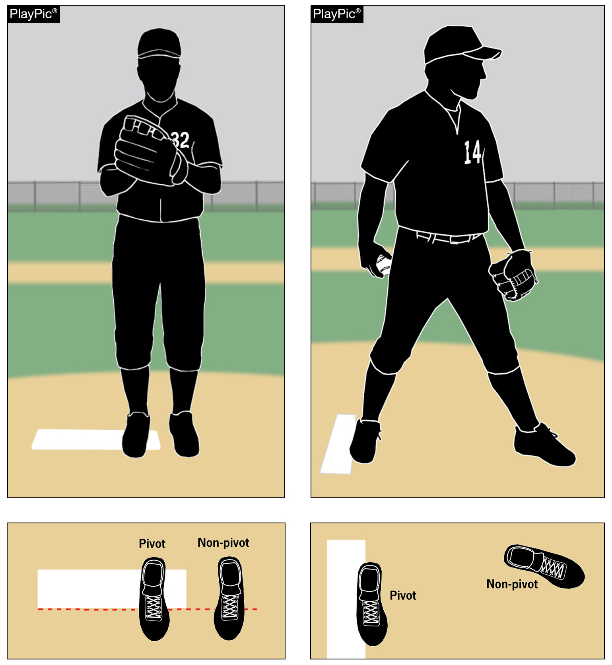
PROPER PITCHING POSITIONS
The position of the pivot foot determines which of the pitching positions is being used.
In the wind-up position, the pitcher’s pivot foot is in contact with the pitcher’s plate and is not parallel to it.
In the set position, the pivot foot is in contact with or directly in front of and parallel to the pitcher’s plate.

Slide 51
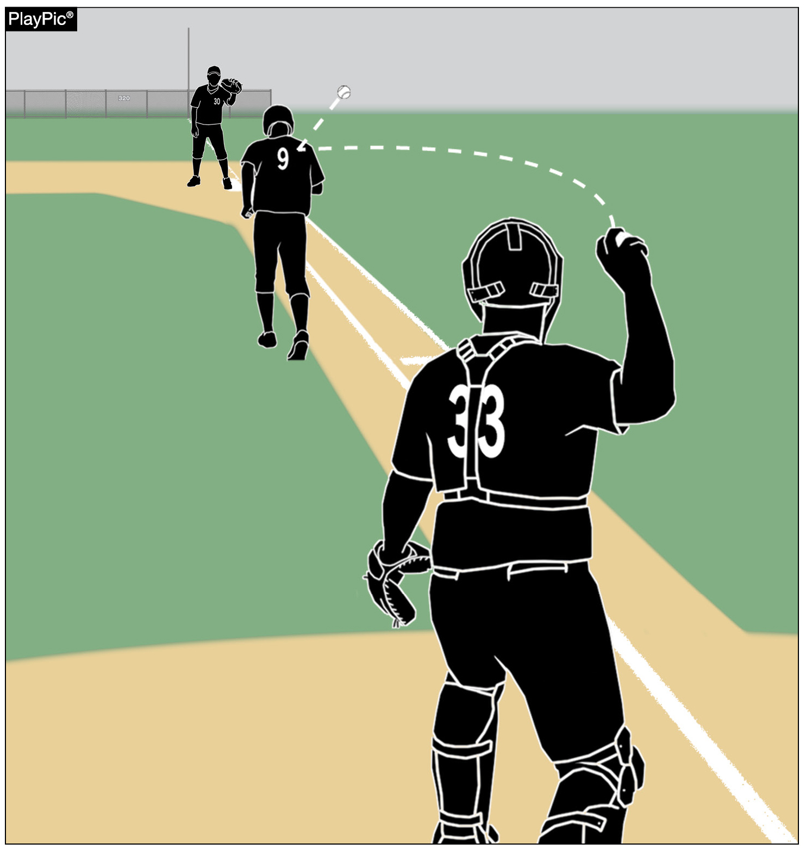
RUNNING LANE AWARENESS
Enforcing the running lane rule (8-4-1g) is vital for player safety, fairness and the educational goals of high school baseball.
The batter-runner must use the designated lane in foul territory during a play at first base.

Slide 52
RUNNING LANE AWARENESS
1. Safety – The lane prevents collisions and protects both the runner and the fielder.
2. Fair Play – Staying in the lane avoids unfair interference with defensive plays.
3. Consistency – Regular enforcement promotes accountability and discourages rule violations.
4. Education – Teaching proper lane use reinforces respect for the rules of the game.

Slide 53
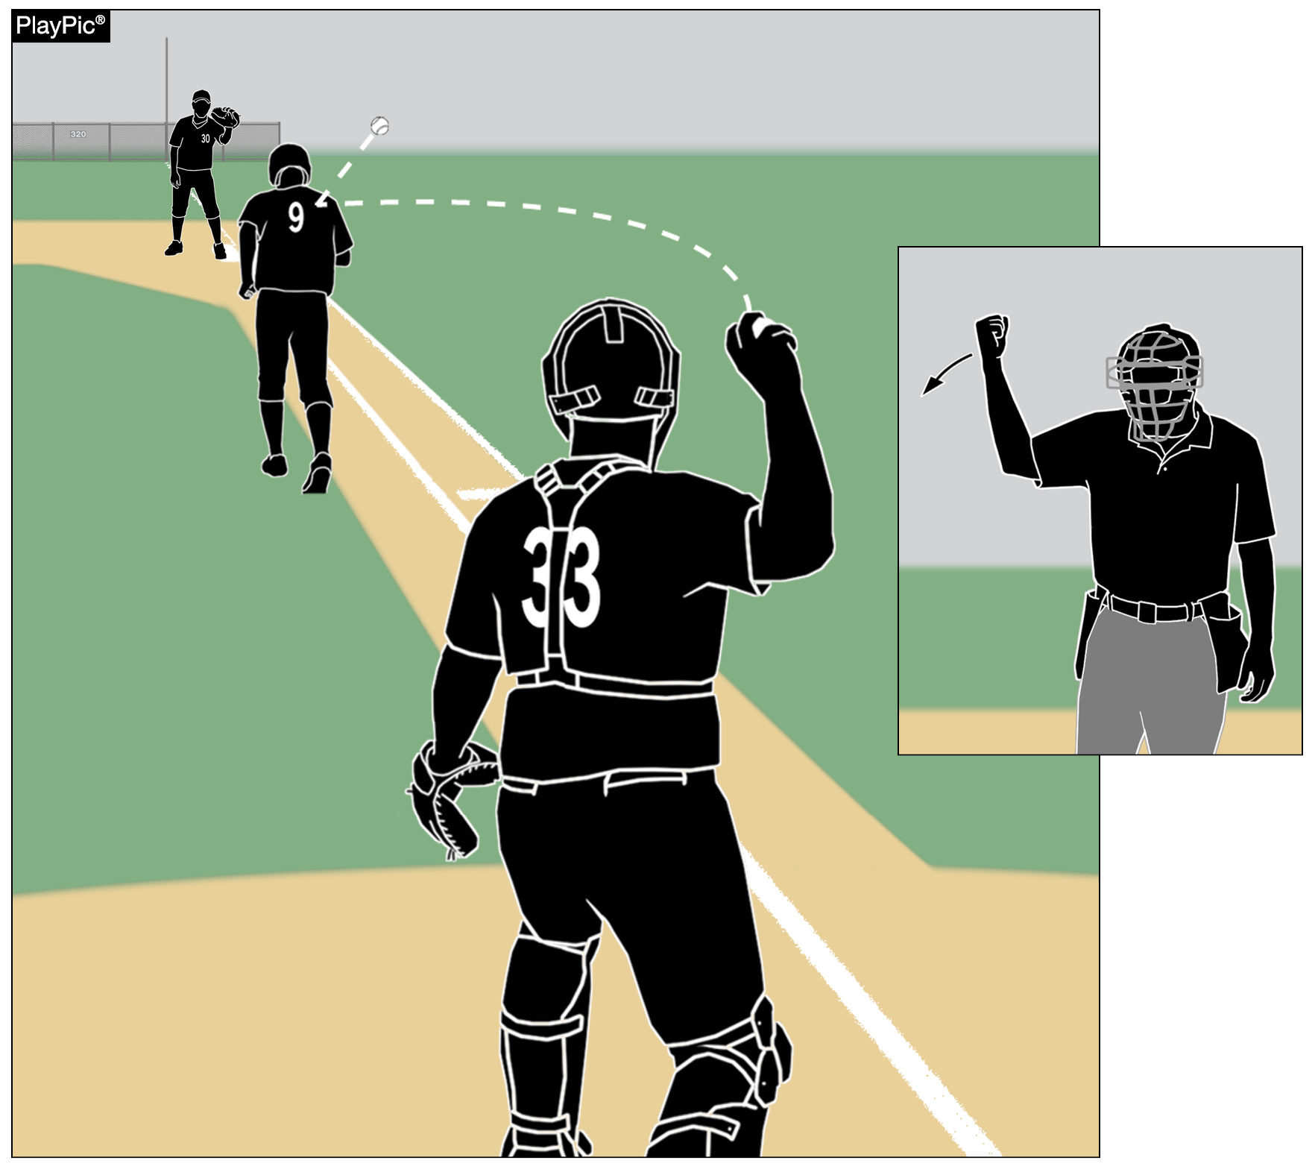
RUNNING LANE AWARENESS
Violations result in interference, with the batter-runner out and runners returned to their previous base.

Slide 54
NFHS.org Phone # Email

